Slide 1
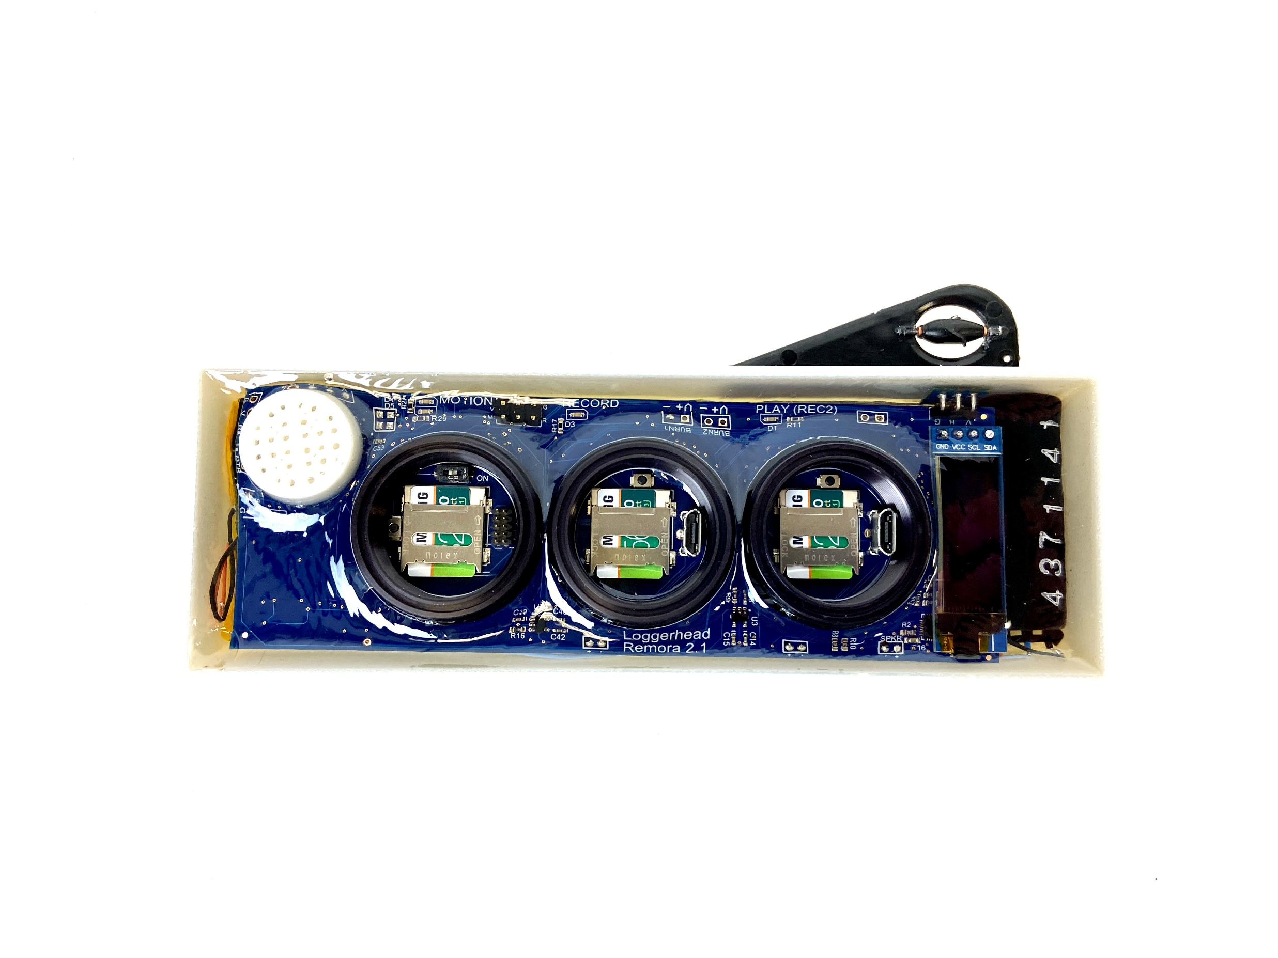
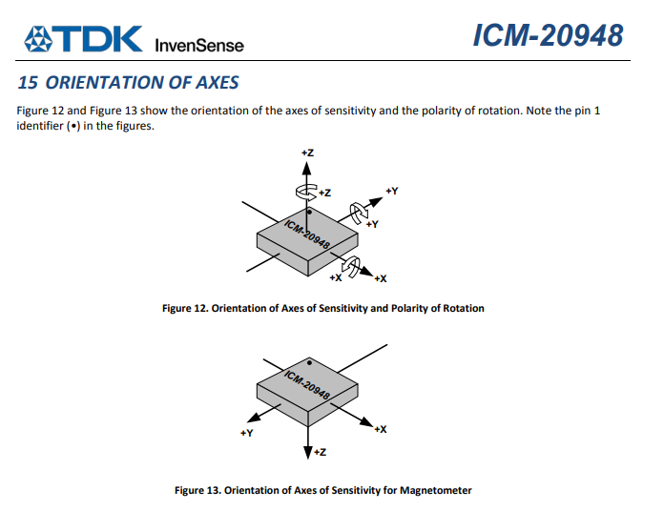
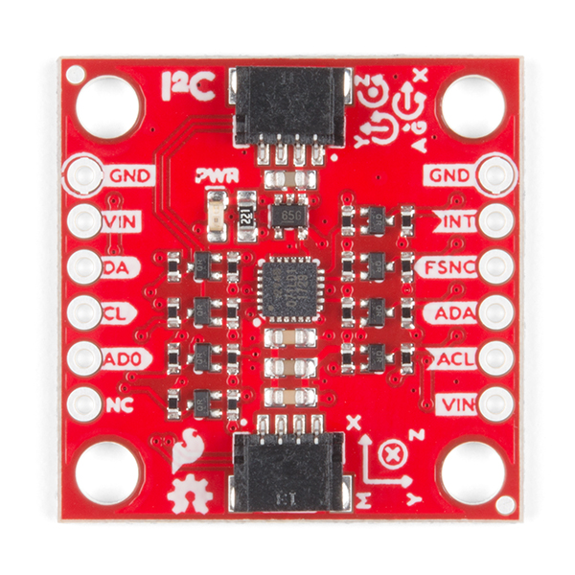
Impeller with magnet
Depth Sensor
Charge
Hall sensor
Power switch
Stop
hydrophone
+X
+Y
Sparkfun IMU board is mounted upside down. Note orientation of magnetometer in the chip is different than accelerometer and gyroscope.

